Slide 1
Ares One
A Game By Julian van Riet

Slide 2
Initial Intent
My project was intended to be a 2D rogue-like game, programmed in Unity using C#, that had a sci-fi theme.
I wanted the game to have a rich backstory and exude the feeling that the player is on Mars.
The game mechanics were intended to include a large, expansive map and the ability for the player to collect different weapons to defend themselves against enemies.
The uniqueness of my game would stem from the fact that it would be a survival game with an action focus.

Slide 3
Initial Intent
I wanted to make this project because I have experience in developing 2D games and didn’t want to struggle in the development of the game due to unfamiliarity with the what I was programming.
I thought that the idea of the game was interesting and would make the game something people would want to play.
I thought that it would be better to have an indie game feel with the 2D graphics.

Slide 4
Making of the Project
I utilized the Unity framework and programmed the scripts in C# in the development of this game.
The music, sound effects, and sprites found in the current iteration of the game were taken from websites providing royalty-free resources.

Slide 5
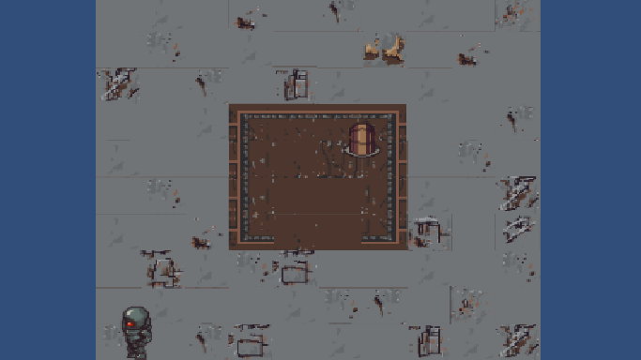
Making of the Project
The biggest issue I encountered with my project was the realization that my goals for the game were too ambitious and, as a result, I was not going to complete a good game by the end of the year.
Initially, the game was a rogue-like game, as planned, that looked like this:

Slide 6
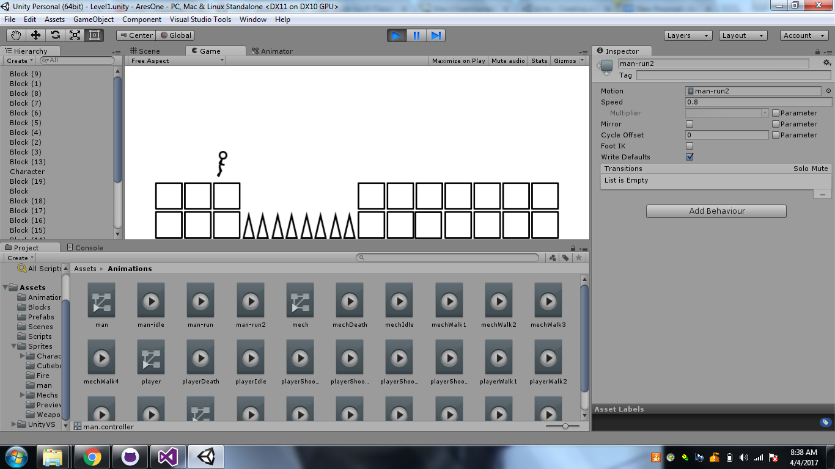
Making of the Project
I re-envisioned the game I was trying to make, trying to incorporate old elements while changing the game into something I new I could get done and make enjoyable.
This is what I transitioned to:

Slide 7

End Game
My game at the moment is a 2D platformer with a clean, simplistic look but sufficiently enjoyable mechanics.
The game has a start screen, loads new levels when the player gets to the end of one, and restarts the game if the player dies.

Slide 8
What Next?
I was unable to finish the pause function, which would have allowed players to pause the game if necessary.
In the future I would like to include this feature, as well as an options menu that lets turn on and off both music and sound effects.
The main thing I would like to implement would be more levels to extend the duration of the game.

Slide 9
Any Questions?

